Slide 1
3조
조장 | 유경환
곽대현 | 전제현
김규민 | 박재호
전민석 | 이준민

Slide 2
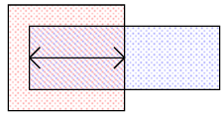

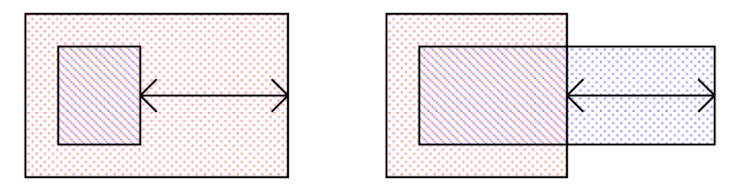
Definition
Spacing
Overlap
한 도형의 외곽경계에서 다른 도형의 외곽까지의 거리
두 도형이 서로 겹쳐 있는 영역의 거리
Enclosure
Parallel length
한 도형이 다른 도형을 얼마나 감싸고 있는지를 나타내는 거리
두 도형의 서로 마주보는 가장자리가 겹쳐 있는 길이

Slide 3
Layer colors
STI
Substrate
Nwell
POLY / Gate
METAL
VIA
IMD
ILD
Sillicide
P+
N+
CONTACTt
OXIDE
Thick OXIDE
SIPROT

Slide 4
Nwell

Slide 5
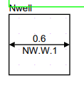
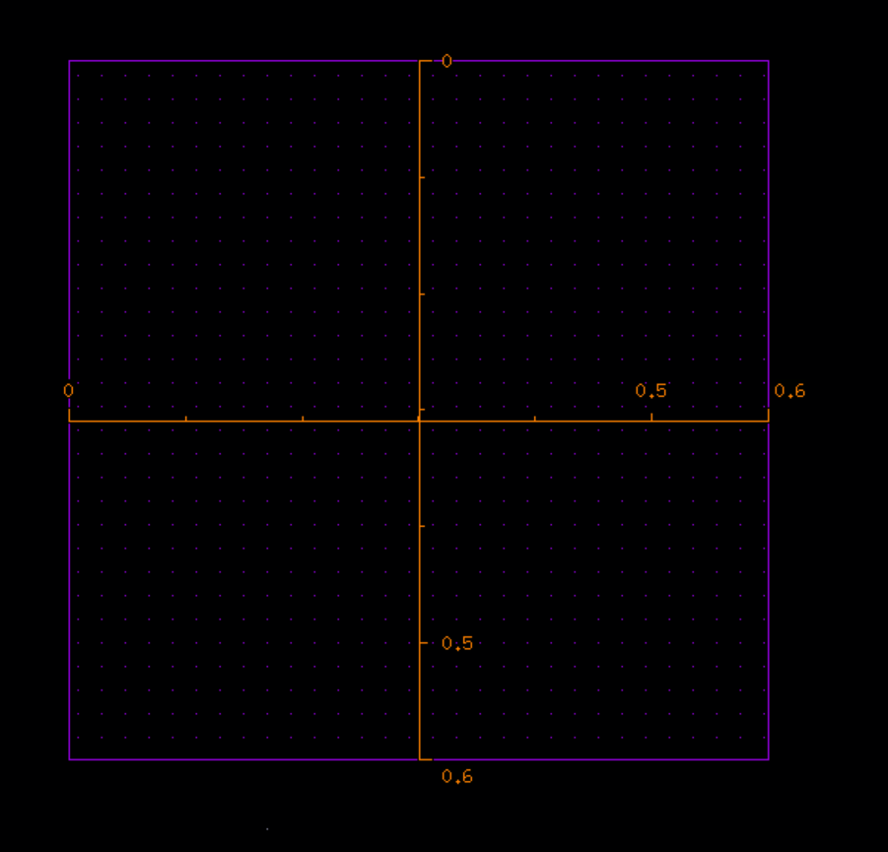
Rule Name | Value | Description
NW.W.1 | 0.6um | Minimum Nwell width
Schematic in Design Rule Manual
Cadence Reproducing and vertical structure
✄
Nwell의 폭이 너무 좁으면 공정 오차로 인해
well이 정상적으로 형성되지 않을 수 있다.
0.6um
0.6um
0.6um
Substrate
Nwell

Slide 6
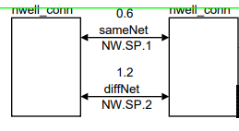
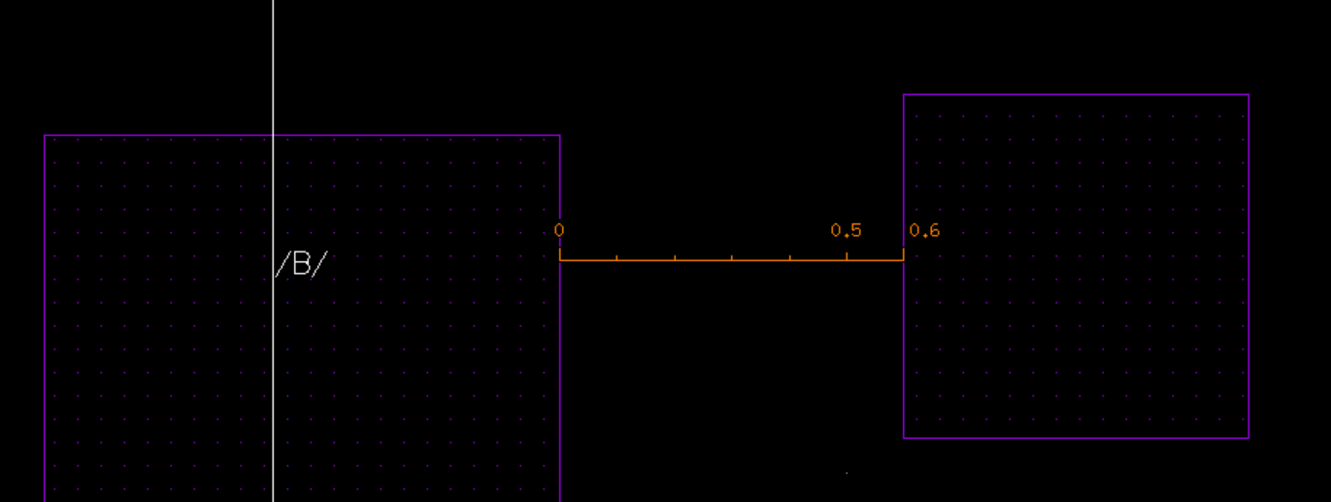
Rule Name | Value | Description
NW.SP.1 | 0.6um | Minimum Nwell spacing to Nwell (same potential)
Schematic in Design Rule Manual
Cadence Reproducing and vertical structure
✄
Nwell의 간격이 너무 좁으면 공정 오차로 인해
well이 서로 붙거나 형상이 변형돼
punch-through 현상이나 latch-up 현상이 일어날 수 있다.
0.6um
0.6um
Nwell
Substrate
Nwell

Slide 7
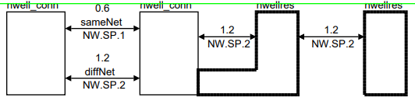
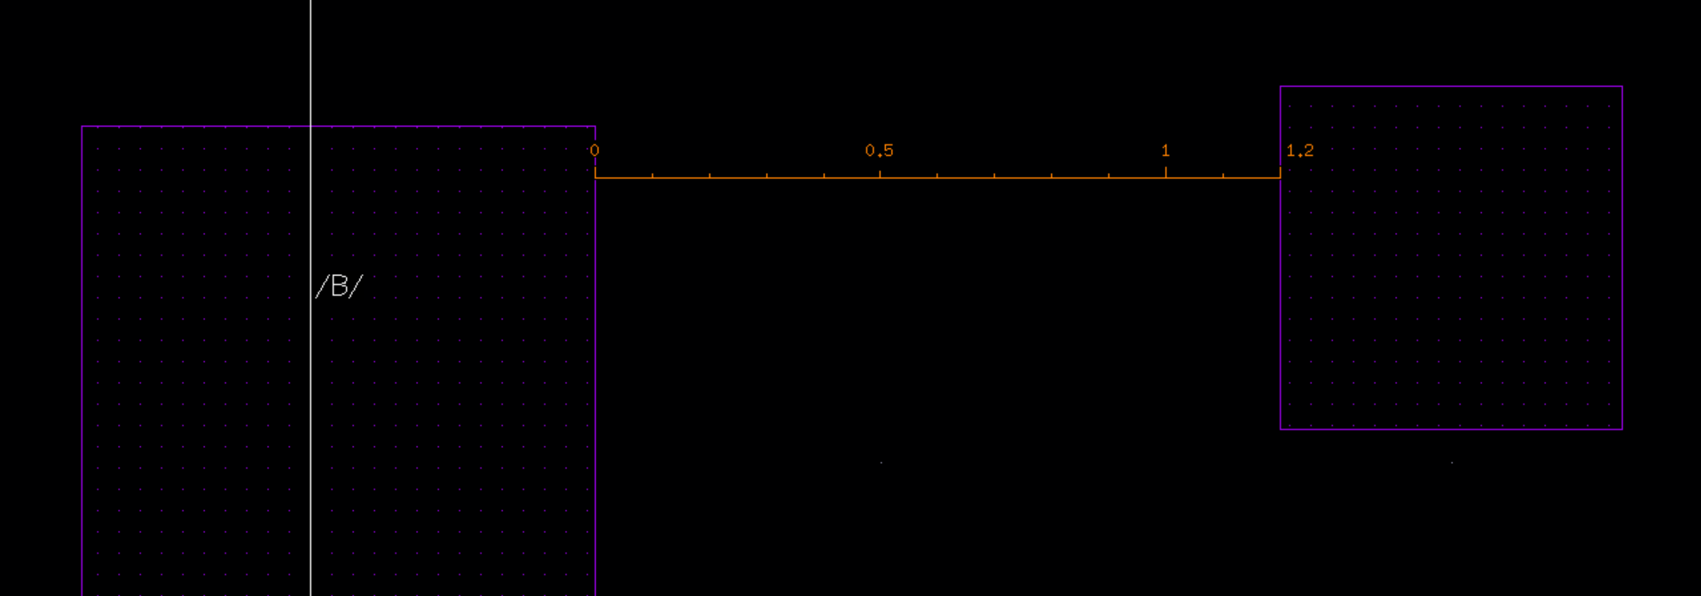
Rule Name | Value | Description
NW.SP.2 | 1.2um | Minimum Nwell spacing to Nwell (different potential)
Schematic in Design Rule Manual
Cadence Reproducing and vertical structure
✄
서로 다른 전압이 인가되면 넓어지는 depletion 영역으로 인해 leakage path가 발생할 가능성이 더 커지므로
더 큰 최소 간격이 필요하다.
1.2um
1.2um
Substrate
Nwell
Nwell

Slide 8
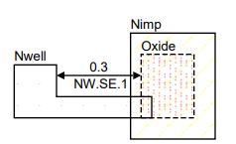
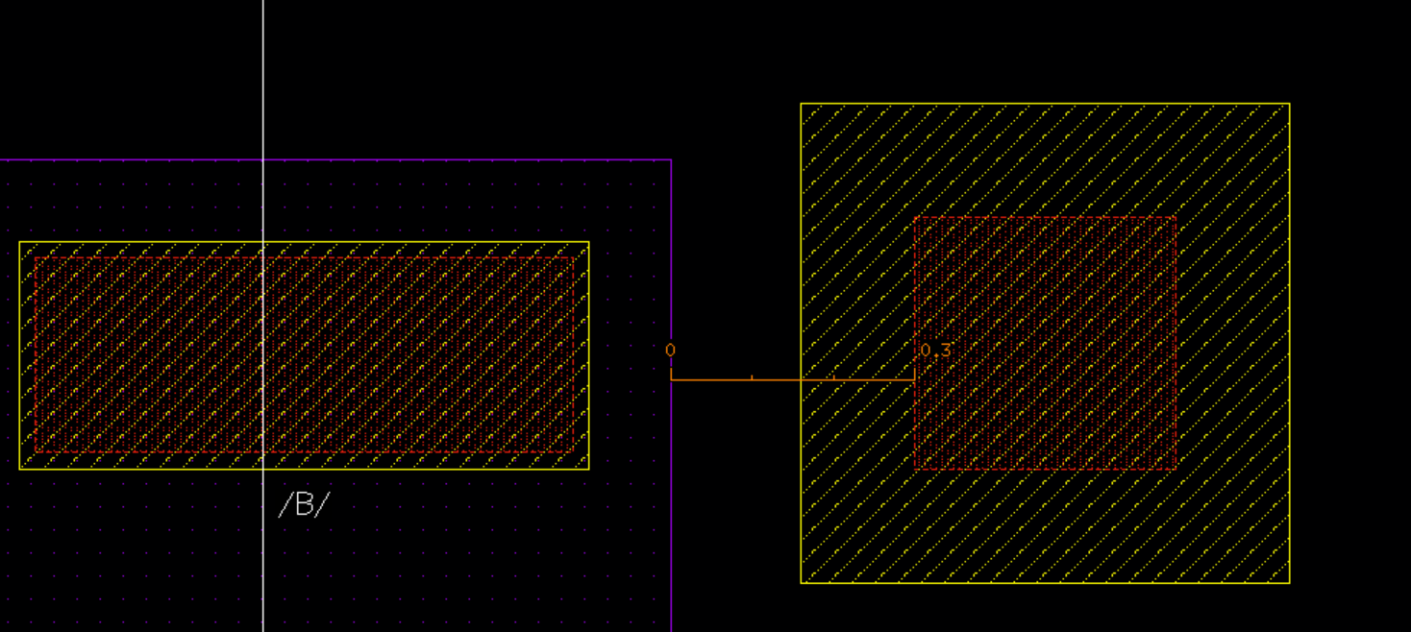
Rule Name | Value | Description
NW.SE.1 | 0.3um | Minimum Nwell spacing to N+ Active Area
Schematic in Design Rule Manual
Cadence Reproducing and vertical structure
✄
두 영역이 너무 가까우면
latch up으로 인한 leakage path 현상이 발생할 수 있다.
0.3um
0.3um
OXIDE
STI
N+
STI
Nwell

Slide 9
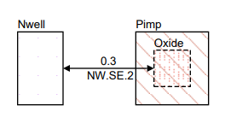
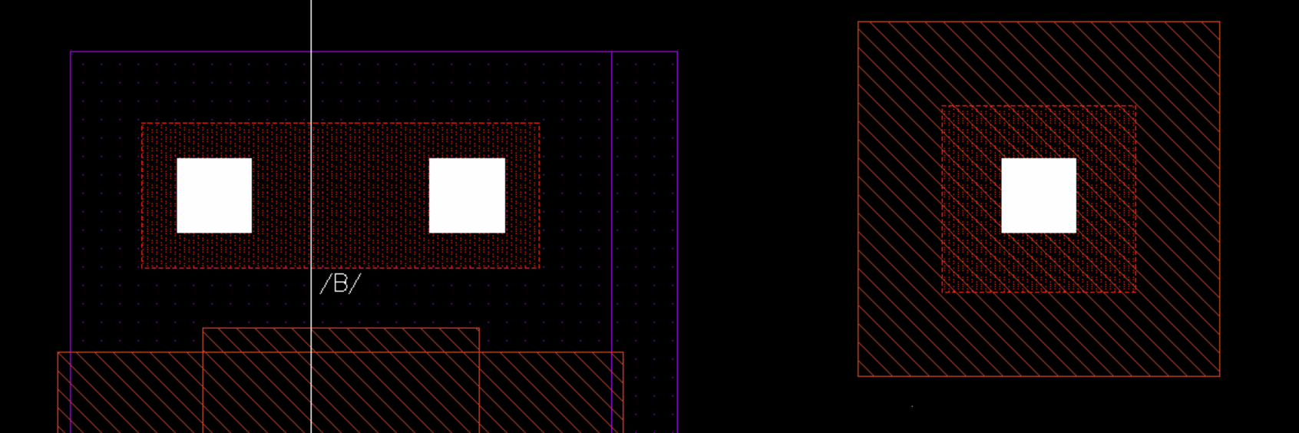
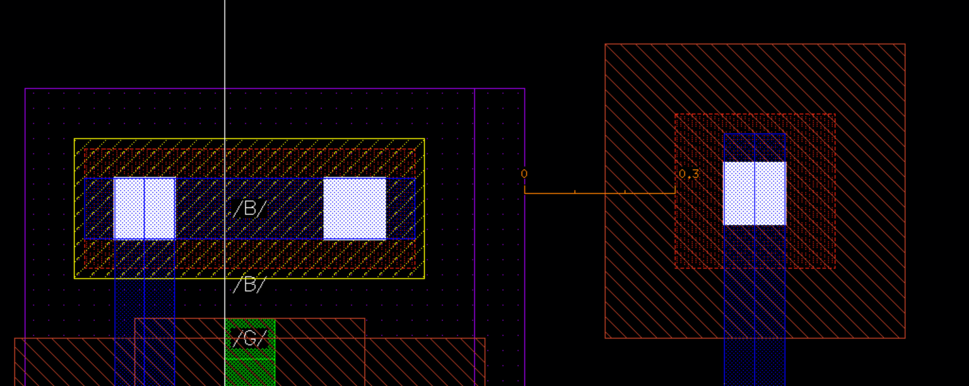
Rule Name | Value | Description
NW.SE.2 | 0.3um | Minimum Nwell spacing to P+ Active Area
Schematic in Design Rule Manual
Cadence Reproducing and vertical structure
두 영역이 너무 가까우면
latch up으로 인한 leakage path 현상이 발생할 수 있다.
✄
0.3um
0.3um
OXIDE
STI
P+
STI
Nwell

Slide 10
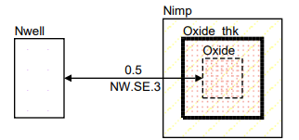
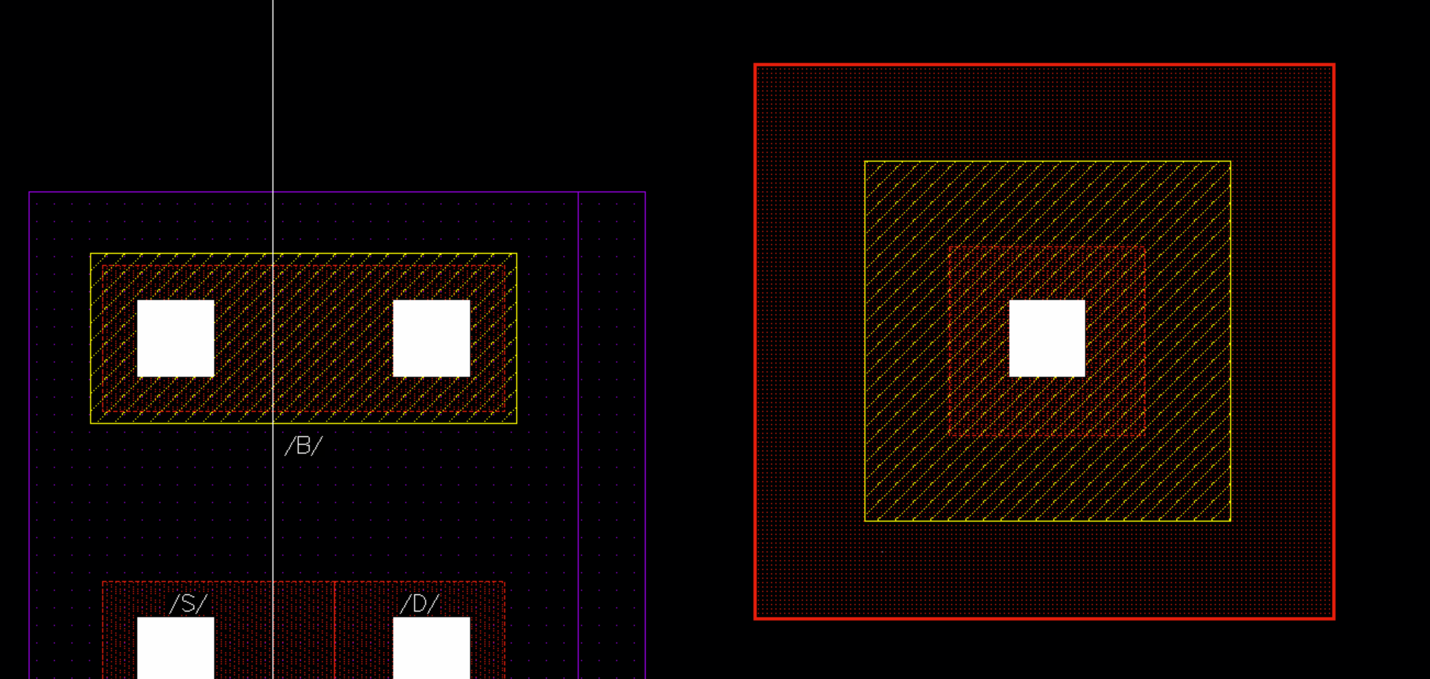
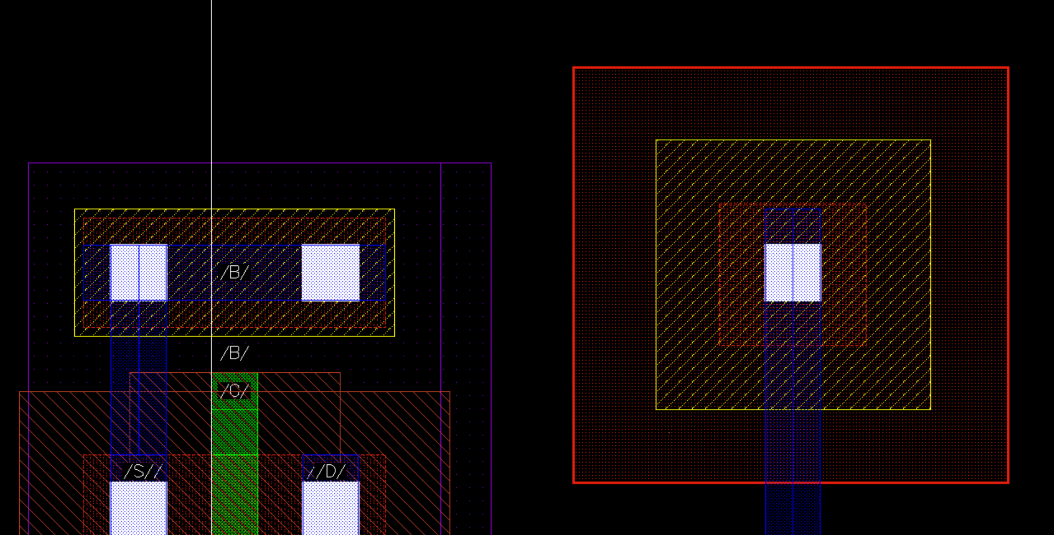
Rule Name | Value | Description
NW.SE.3 | 0.5um | Minimum Nwell spacing to N+ 2.5V Active Area
Schematic in Design Rule Manual
Cadence Reproducing and vertical structure
✄
더 큰 전압이 인가되어 더 큰 간격을 확보해야
leakage path 현상이 발생하지 않는다.
0.5um
0.5um
Thick OXIDE
STI
N+
STI
Nwell

Slide 11
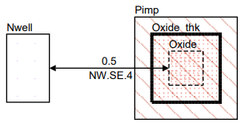
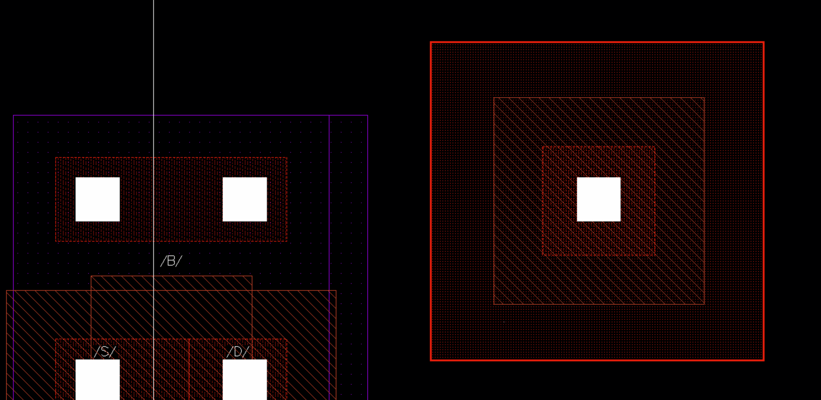
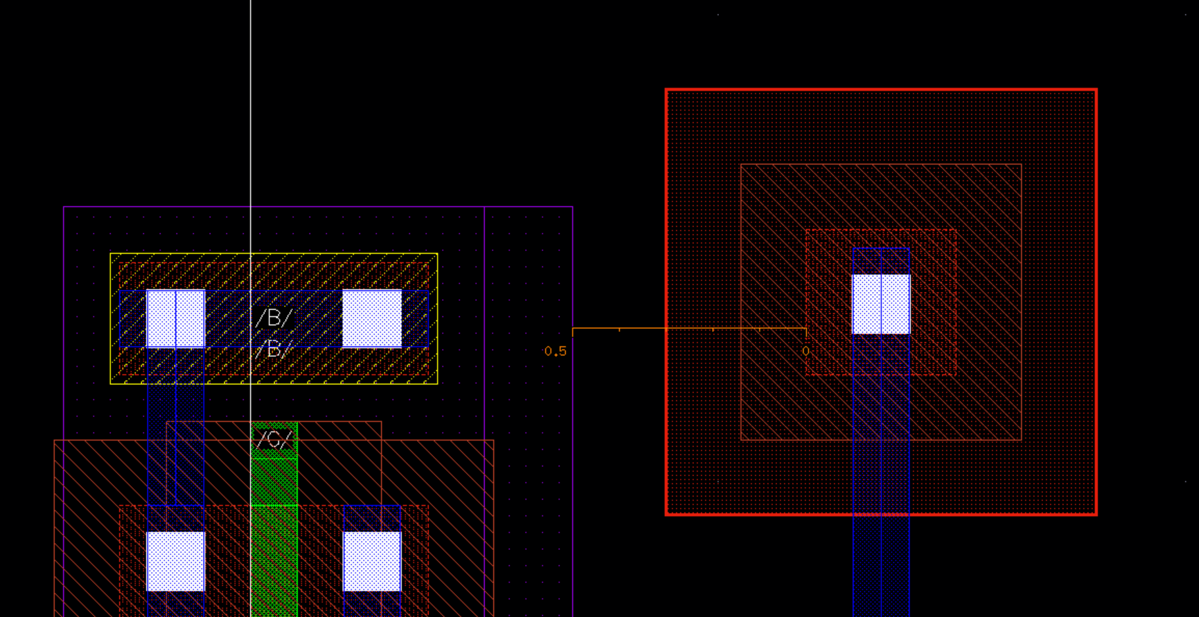
Rule Name | Value | Description
NW.SE.4 | 0.5um | Minimum Nwell spacing to P+ 2.5V Active Area
Schematic in Design Rule Manual
Cadence Reproducing and vertical structure
✄
더 큰 전압이 인가되어 더 큰 간격을 확보해야
leakage path 현상이 발생하지 않는다.
0.5um
0.5um
Thick OXIDE
STI
P+
STI
Nwell

Slide 12
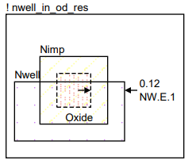
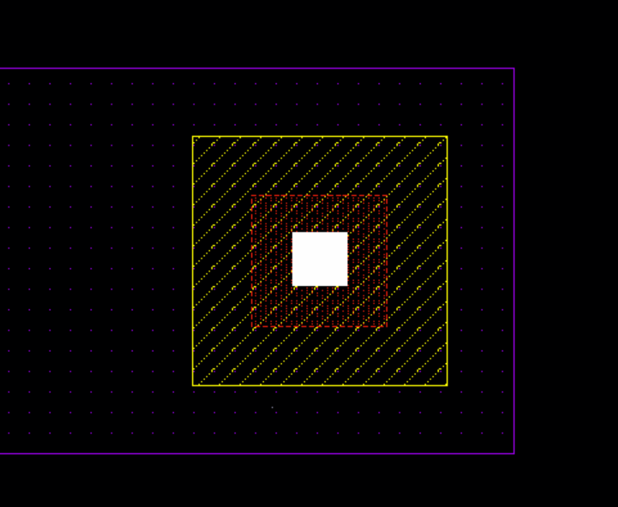
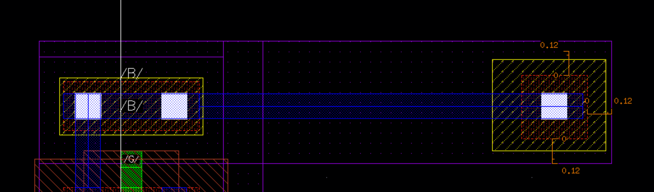
Rule Name | Value | Description
NW.E.1 | 0.12um | Minimum Nwell enclosure of N+ Active Area
Schematic in Design Rule Manual
Cadence Reproducing and vertical structure
✄
enclosure가 부족하면 공정 오차로 인해 active area가 Nwell 밖으로 벗어날 수 있어 안정된 active를 형성하기 위해 필요하다.
0.12um
0.12um
0.12um
0.12um
0.12um
STI
OXIDE
STI
N+
0.12um
Nwell

Slide 13
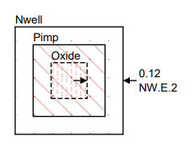
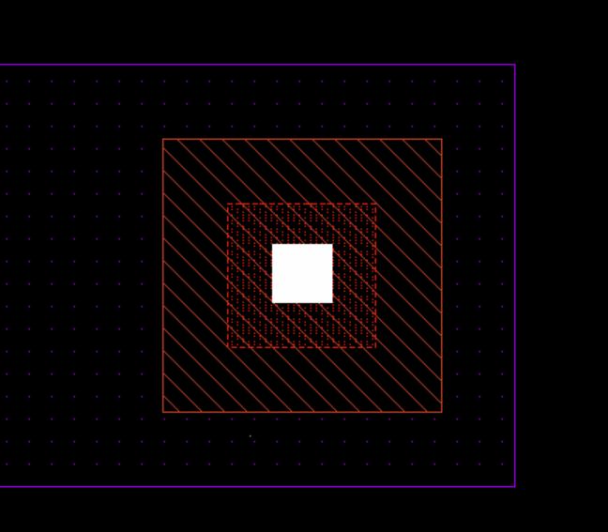
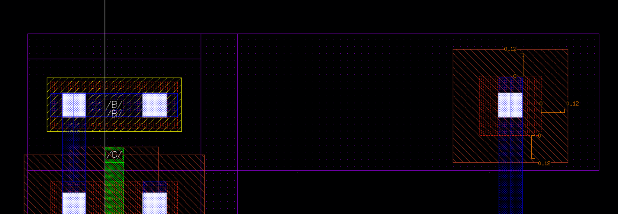
Rule Name | Value | Description
NW.E.2 | 0.12um | Minimum Nwell spacing to P+ 2.5V Active Area
Schematic in Design Rule Manual
Cadence Reproducing and vertical structure
✄
enclosure가 부족하면 공정 오차로 인해 active area가 Nwell 밖으로 벗어날 수 있어 안정된 active를 형성하기 위해 필요하다.
0.12um
0.12um
0.12um
0.12um
0.12um
OXIDE
STI
P+
STI
0.12um

Slide 14
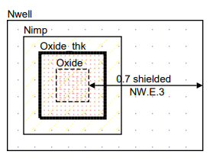
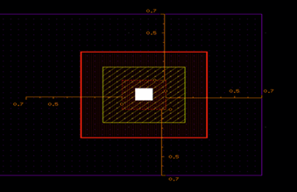
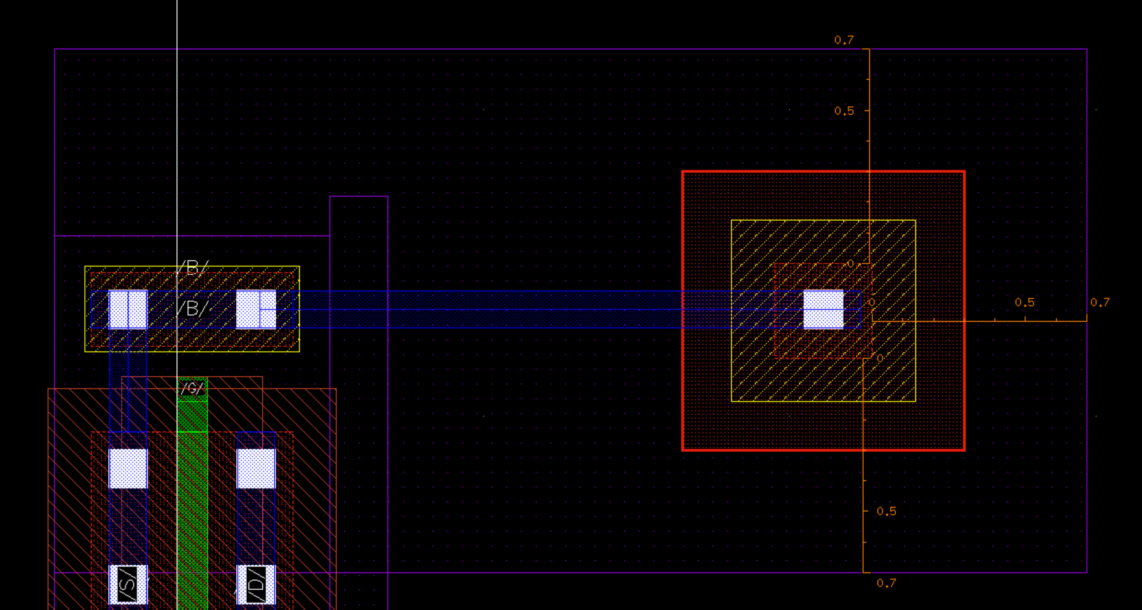
Rule Name | Value | Description
NW.E.3 | 0.7um | Minimum Nwell enclosure of N+ 2.5V Active Area
Schematic in Design Rule Manual
Cadence Reproducing and vertical structure
✄
더 큰 전압이 인가되므로 보다 넓은 영역의 Nwell을 형성해야 안정된 active가 형성될 수 있다.
0.7um
0.7um
0.7um
0.7um
0.7um
Thick OXIDE
STI
N+
STI
0.7um

Slide 15
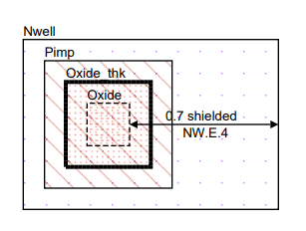
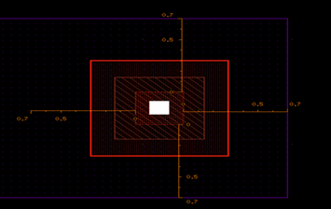
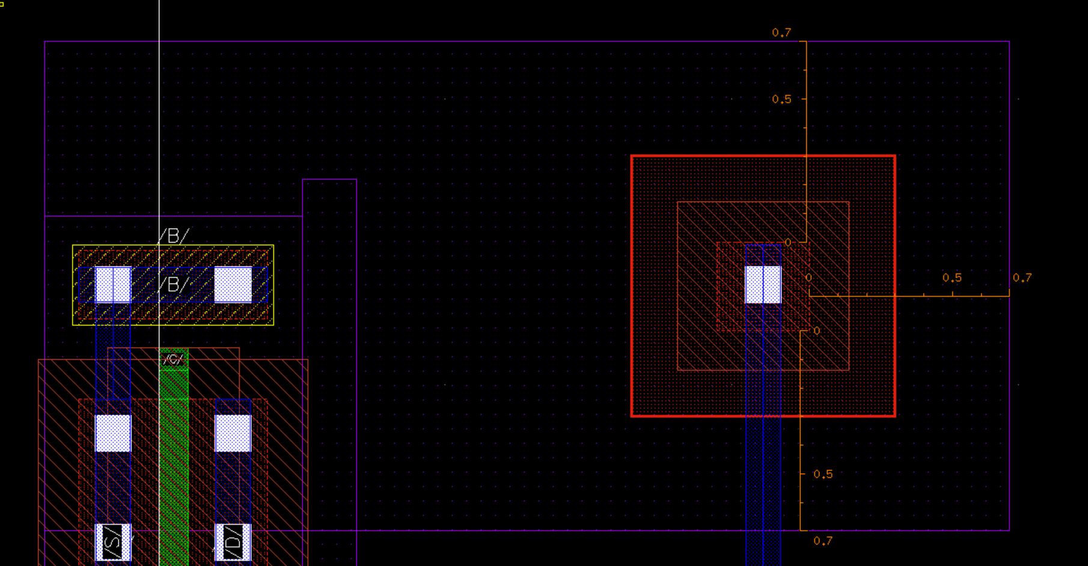
Rule Name | Value | Description
NW.E.4 | 0.7um | Minimum Nwell enclosure of P+ 2.5V Active Area
Schematic in Design Rule Manual
Cadence Reproducing and vertical structure
✄
더 큰 전압이 인가되므로 보다 넓은 영역의 Nwell을 형성해야 안정된 active가 형성될 수 있다.
0.7um
0.7um
0.7um
0.7um
0.7um
Thick OXIDE
STI
P+
STI
0.7um

Slide 16
Oxide

Slide 17
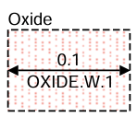
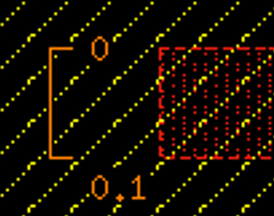
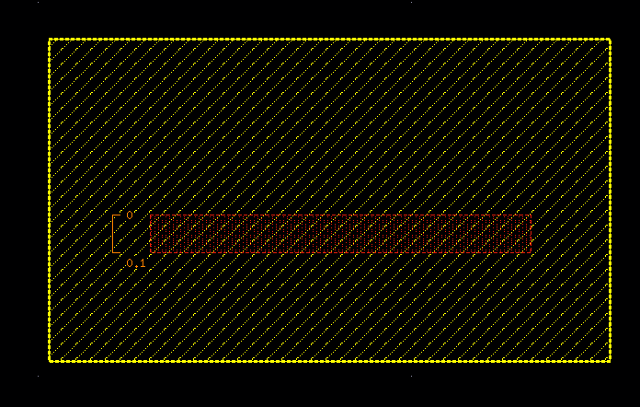
Rule Name | Value | Description
OXIDE.W.1 | 0.1um | Minimum Active Area width
Schematic in Design Rule Manual
Cadence Reproducing and vertical structure
빛의 회절 한계로 인해 패터닝 가능한 최소 실리콘 영역, oxide를 균일하게 채워 넣을 수 있는 최소 물리적 공간을 의미
0.1um
0.1um
STI
OXIDE
STI
Substrate
N+

Slide 18
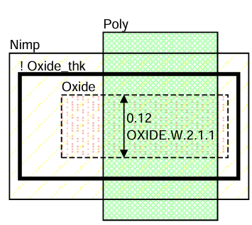
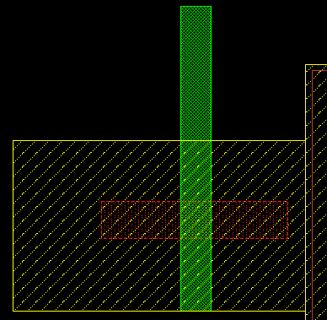
Rule Name | Value | Description
OXIDE.W.2.1.1 | 0.12um | Minimum 1.2V N-channel gate width
Schematic in Design Rule Manual
Cadence Reproducing and vertical structure
폭이 너무 좁아지면 문턱 전압 변동성이 커지고 누설 전류가 증가하므로 이를 방지하고 안정적인 전류를 확보하기 위한 최소 채널 폭
0.12um
STI
STI
Substrate
0.12um

Slide 19
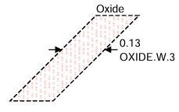
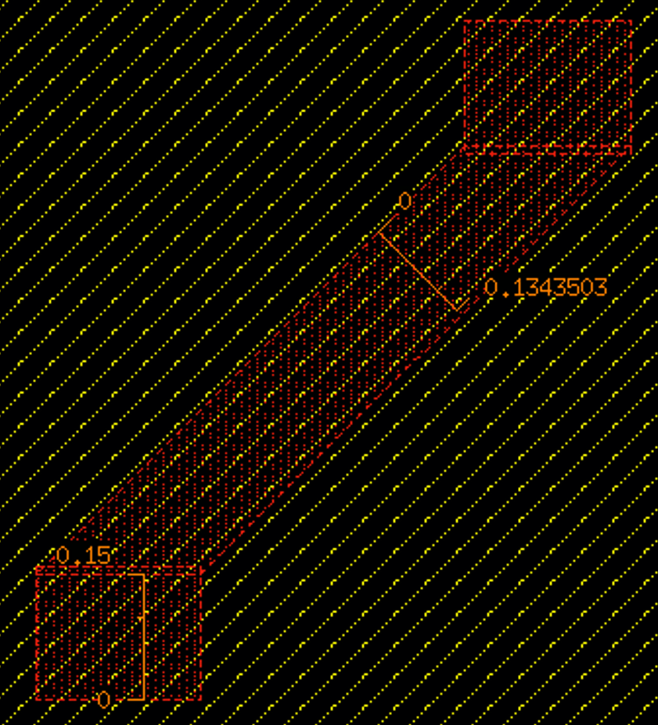
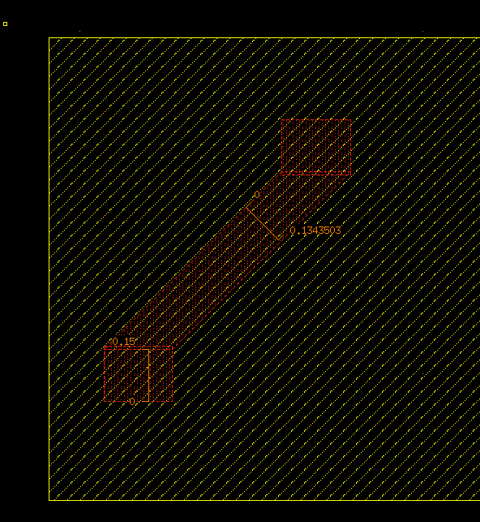
Rule Name | Value | Description
OXIDE.W.3 | 0.13um | Minimum Active Area bent 45 degrees width
Schematic in Design Rule Manual
Cadence Reproducing and vertical structure
포토리소그래피 공정에서 45도 사선 마스크 패턴은 격자배치 및 노광 시 감광액이 잘려 나가는
현상이 발생해서 0.13µm보다 두꺼운 설계 필요
0.13um
STI
STI
Substrate
0.13um

Slide 20
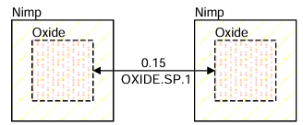
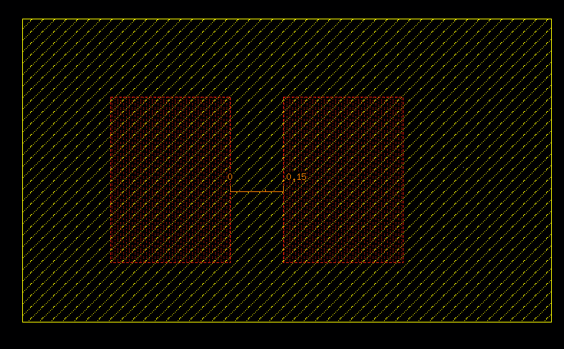
Rule Name | Value | Description
OXIDE.SP.1 | 0.15um | Minimum N+ Active Area to N+ Active Area spacing
Schematic in Design Rule Manual
Cadence Reproducing and vertical structure
두 Active 패턴 사이의 거리가 너무 가까우면
STI 식각 후 Oxide를 채워 넣을 때
내부에 빈 공간이 생겨 short가 발생할 수 있음
0.15um
STI
OXIDE
OXIDE
0.15um
N+
N+
STI
Substrate

Slide 21
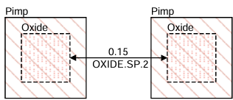
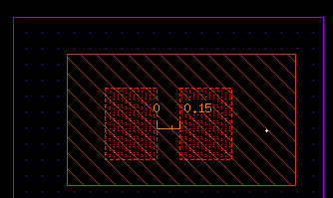
Rule Name | Value | Description
OXIDE.SP.2 | 0.15um | Minimum P+ Active Area to P+ Active Area spacing
Schematic in Design Rule Manual
Cadence Reproducing and vertical structure
두 Active 패턴 사이의 거리가 너무 가까우면
STI 식각 후 Oxide를 채워 넣을 때
내부에 빈 공간이 생겨 short가 발생할 수 있음
0.15um
STI
OXIDE
OXIDE
P+
P+
STI
Nwell
Substrate

Slide 22
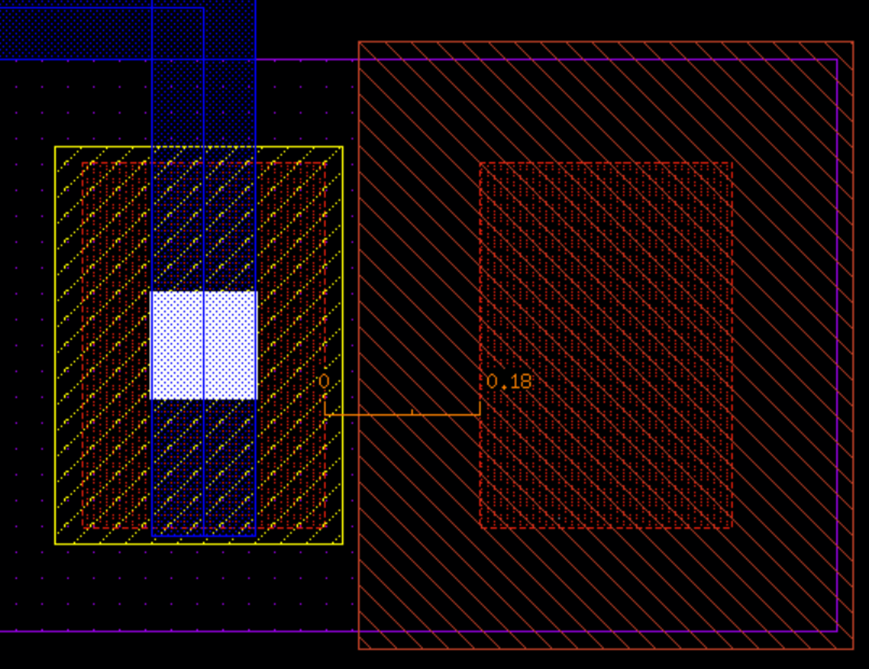
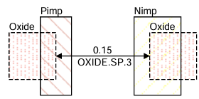
Rule Name | Value | Description
OXIDE.SP.3 | 0.15um | Minimum N+ Active Area to P+ Active Area spacing
Schematic in Design Rule Manual
Cadence Reproducing and vertical structure
두 Active 패턴 사이의 거리가 너무 가까우면
STI 식각 후 Oxide를 채워 넣을 때
내부에 빈 공간이 생겨 short가 발생할 수 있음
0.18um
STI
OXIDE
OXIDE
N+
P+
STI
Nwell
0.18um
Substrate

Slide 23
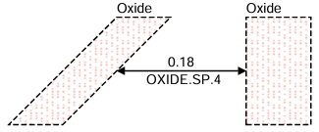
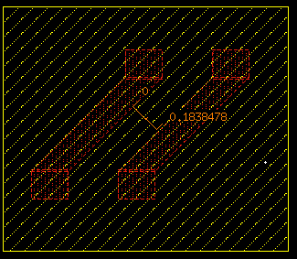
Rule Name | Value | Description
OXIDE.SP.4 | 0.18um | Minimum Active Area bent 45 degrees to Active Area spacing
Schematic in Design Rule Manual
Cadence Reproducing and vertical structure
45도 기울어진 패턴이 맞닿는 부분은
빛의 간섭 현상으로 인해
마스크 패턴이 쉽게 뭉개지거나 연결될 위험이 큼
0.18um
0.18um
STI
STI
Substrate

Slide 24

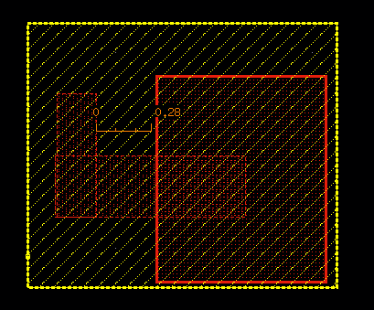
Rule Name | Value | Description
OXIDE.SE.1 | 0.28um | Minimum Active Area to Thick Active Area spacing
Schematic in Design Rule Manual
Cadence Reproducing and vertical structure
얇은 oxide와 두꺼운 oxide 영역을 구분하기 위해 'Dual Oxide Mask'를 사용하는
추가 Etch 공정이 들어가며 두 영역 간의
마스크 정렬 오차 안정성을 보장하기 위해
일반 간격보다 훨씬 넓은 마진(0.28um)이 필요
0.28um
0.28um
Thick OXIDE
N+
STI
Substrate

Slide 25

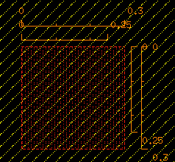
Rule Name | Value | Description
OXIDE.A.1 | 0.06um | Minimum area for Active Area
Schematic in Design Rule Manual
Cadence Reproducing and vertical structure
Active 면적이 너무 작은 형태로 존재하면
CMP 공정 중에 연마 패드의 강한 마찰력을
견디지 못하고 패턴이 탈락되어 웨이퍼 오염을 유발
0.3um
0.3um
STI
OXIDE
STI
N+
Substrate

Slide 26
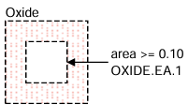

Rule Name | Value | Description
OXIDE.EA.1 | 0.1um | Minimum Active Area enclosed area ("donut" hole surrounded by Active Area)
Schematic in Design Rule Manual
Cadence Reproducing and vertical structure
Active 영역이 도넛 형태로 둘러싸고 있는 내부 구멍이 너무 작으면 식각 액체나 세정 케미컬의
표면장력 때문에 액체가 갇히므로
이로 인해 미식각 영역이 남는 결함이 발생
0.5um
0.5um
0.2um
STI
STI
Substrate

Slide 27



Rule Name | Value | Description
OXIDE.L.1 | 22um | Maximum Oxide length between two contacts when the Oxide width is <= 0.18um.
Schematic in Design Rule Manual
Cadence Reproducing and vertical structure
0.18 µm 이하의 얇은 Active 선이
컨택(Contact) 없이 너무 길게 늘어서면
심각한 전압 강화(IR Drop) 및 RC delay가 발생
Contact ~ Contact 사이 거리 22um
22um
METAL
22um
ILD
OXIDE
N+
STI
Substrate

Slide 28



Rule Name | Value | Description
OXIDE.L.2 | 11um | Maximum Oxide length between one contact and the end of the Oxide line when the Oxide width is <= 0.18um
Schematic in Design Rule Manual
Cadence Reproducing and vertical structure
0.18 µm 이하의 얇은 Active 선이
컨택(Contact) 없이 너무 길게 늘어서면
심각한 전압 강화(IR Drop) 및 RC delay가 발생
Contact ~ Oxide 끝 사이 거리 11um
11um
11um
METAL
ILD
OXIDE
N+
STI
Substrate

Slide 29
POLY

Slide 30


Rule Name | Value | Description
POLY.W.1 | 0.1um | Minimum 1.2V N-channel gate length
Schematic in Design Rule Manual
Cadence Reproducing and vertical structure
✄
“Short Channel Effect와 누설전류 증가를 방지하기 위해 NMOS의 최소 Gate Length를 제한”
0.1um
STI
OXIDE
STI
Substrate
N+
N+
0.1um

Slide 31


Rule Name | Value | Description
POLY.W.2 | 0.1um | Minimum 1.2V P-channel gate length
Schematic in Design Rule Manual
Cadence Reproducing and vertical structure
✄
“PMOS의 전기적 특성과 신뢰성을 유지하기 위해 최소 Gate Length를 제한”
0.1um
STI
OXIDE
STI
P+
Nwell
P+
Substrate
0.1um

Slide 32


Rule Name | Value | Description
POLY.W.3 | 0.28um | Minimum 2.5V N-channel gate length
Schematic in Design Rule Manual
Cadence Reproducing and vertical structure
✄
“고전압 동작 시 Hot Carrier Injection과 Gate Oxide 열화를
방지하기 위해 최소 Gate Length를 제한”
0.28um
STI
Thick OXIDE
STI
Substrate
N+
N+
0.28um

Slide 33


Rule Name | Value | Description
POLY.W.4 | 0.28um | Minimum 2.5V P-channel gate length
Schematic in Design Rule Manual
Cadence Reproducing and vertical structure
✄
“고전압 동작 시 Hot Carrier Injection과 Gate Oxide 열화를
방지하기 위해 최소 Gate Length를 제한”
0.28um
Thick OXIDE
STI
P+
STI
Nwell
P+
Substrate
0.28um

Slide 34


Rule Name | Value | Description
POLY.W.5 | 0.1um | Minimum Poly interconnect width
Schematic in Design Rule Manual
Cadence Reproducing and vertical structure
q
“Poly 배선의 단선과 저항 증가를 방지하기 위해 최소 Poly 폭을 규정”
0.1um
0.1um

Slide 35



Rule Name | Value | Description
POLY.SP.1 | 0.6um | Minimum Poly resistor space
Schematic in Design Rule Manual
Cadence Reproducing and vertical structure
“Poly 저항의 저항값 오차와 공정 간섭을 줄이기 위해 최소 간격을 확보”
0.6um
0.6um
STI
Substrate

Slide 36



Rule Name | Value | Description
POLY.SP.2 | 0.12um | Minimum gate space
Schematic in Design Rule Manual
Cadence Reproducing and vertical structure
✄
“인접한 Gate의 브리징과 기생 capacitor 증가를 방지하기 위해 최소 Gate 간격을 유지.”
0.12um
0.12um
STI
OXIDE
STI
N+
N+
Substrate

Slide 37


Rule Name | Value | Description
POLY.SP.3 | 0.12um | Minimum Poly interconnect space
Schematic in Design Rule Manual
Cadence Reproducing and vertical structure
“Poly 배선 간 브리징과 signal 간섭을 방지하기 위해 최소 배선 간격을 유지”
0.12um
0.12um
STI
Substrate

Slide 38



Rule Name | Value | Description
POLY.E.1 | 0.18um | Minimum N-channel gate extension beyond Active Area
Schematic in Design Rule Manual
Cadence Reproducing and vertical structure
✄
“Gate Contact 배치 공간을 확보하고 Overlay 오차를 보상하기 위해 Gate Poly를 Active 밖으로 충분히 연장”
0.18um
0.18um
STI
OXIDE
STI
Substrate

Slide 39



Rule Name | Value | Description
POLY.E.2 | 0.18um | Minimum P-channel gate extension beyond Active Area
Schematic in Design Rule Manual
Cadence Reproducing and vertical structure
✄
“Gate Contact 배치 공간을 확보하고 Overlay 오차를 보상하기 위해 Gate Poly를 Active 밖으로 충분히 연장”
0.18um
0.18um
STI
OXIDE
STI
Substrate
Nwell

Slide 40



Rule Name | Value | Description
POLY.E.3 | 0.2um | Minimum Active Area (source/drain) to gate enclosure
Schematic in Design Rule Manual
Cadence Reproducing and vertical structure
✄
“Source/Drain과 Gate의 정렬 오차를 보상하고 안정적인 채널 형성을 위해 충분한 Active Enclosure를 확보”
0.2um
0.2um
OXIDE
STI
STI
Substrate
N+
N+

Slide 41



Rule Name | Value | Description
POLY.SE.1_2 | 0.1um | Minimum Poly interconnect to unrelated/related Active Area space
Schematic in Design Rule Manual
Cadence Reproducing and vertical structure
“의도하지 않은 MOS 채널 형성과 단락을 방지하기 위해 Poly와 Active 사이의 최소 간격을 유지”
✄
0.1um
0.1um
POLY / Gate
OXIDE
STI
STI
N+
Substrate

Slide 42


Rule Name | Value | Description
POLY.W.6 | 0.18um | Minimum bent Poly width
Schematic in Design Rule Manual
Cadence Reproducing and vertical structure
“Corner Rounding으로 인한 폭 감소와 단선을 방지하기 위해 Bent Poly의 최소 폭을 규정”
0.18um
POLY / Gate
Substrate
STI
0.18um

Slide 43


Rule Name | Value | Description
POLY.SP.4 | 0.22um | Minimum bent Poly space
Schematic in Design Rule Manual
Cadence Reproducing and vertical structure
“Bent Poly에서 발생하는 패턴 왜곡과 브리징을 방지하기 위해 최소 간격을 적용”
0.18um
0.18um
0.22um
POLY / Gate
POLY / Gate
Substrate
STI
0.22um

Slide 44

Rule Name | Value | Description
POLY.X.1 | --- | Bent gate is not allowed
Schematic in Design Rule Manual
Cadence Reproducing and vertical structure
✄
“균일한 채널 형성과 안정적인 소자 특성을 위해 Bent Gate를 금지. 직선 구조만 사용”
Bends==0
STI
OXIDE
STI
Substrate
N+
N+

Slide 45



Rule Name | Value | Description
POLY.X.2 | --- | Bent Poly resistor is not allowed
Schematic in Design Rule Manual
Cadence Reproducing and vertical structure
“Current Crowding과 저항값 오차를 방지하기 위해 Bent Poly Resistor를 금지”
✄
Bends==0
STI
Substrate

Slide 46


Rule Name | Value | Description
POLY.D.1 | 50% | Maximum Poly density across full chip
Schematic in Design Rule Manual
“Poly Density Ratio를 제한하여 CMP와 식각 공정의 균일성을 확보”

Slide 47


Rule Name | Value | Description
POLY.SE.3 | 25.0 | Minimum Poly segment length (width < 0.14) between two contacts
Schematic in Design Rule Manual
“좁고 긴 Poly의 높은 저항과 IR Drop을 방지하기 위해 최대 Poly Segment Length를 제한”

Slide 48


Rule Name | Value | Description
POLY.A.1 | 0.1 | Minimum area for Poly interconnect
Schematic in Design Rule Manual
“공정에서 안정적으로 패턴을 형성하기 위해 Poly의 최소 면적을 확보”

Slide 49
Implant

Slide 50


Rule Name | Value | Description
NIMP.W.1 | 0.24um | Minimum N+ Implant width
Schematic in Design Rule Manual
Cadence Reproducing and vertical structure
도핑 균일성과 Source/Drain 특성 확보를 위한
최소 N+ Implant width
0.24
0.24
STI

Slide 51


Rule Name | Value | Description
NIMP.SP.1 | 0.24um | Minimum N+ Implant space
Schematic in Design Rule Manual
Cadence Reproducing and vertical structure
도핑 영역 간 간섭 및 Short 방지를 위한
최소 Implant space
0.24
0.24
STI
N+
N+

Slide 52


Rule Name | Value | Description
NIMP.E.1 | 0.14um | Minimum N+ Implant to Active Area enclosure
Schematic in Design Rule Manual
Cadence Reproducing and vertical structure
Active Area의 안정적인 도핑을 위한
최소 Enclosure
0.14
0.14
0.14
OXIDE
STI
N+
STI

Slide 53


Rule Name | Value | Description
NIMP.O.1 | 0.16um | Minimum N+ Implant to Active Area overlap
Schematic in Design Rule Manual
Cadence Reproducing and vertical structure
공정 오차를 고려한 Active Area와 Implant의
최소 Overlap
0.16
0.16
STI
OXIDE
P+
N+
STI

Slide 54


Rule Name | Value | Description
NIMP.SE.1 | 0.16um | Minimum N+ Implant to P+ Active (inside Nwell) Area spacing
Schematic in Design Rule Manual
Cadence Reproducing and vertical structure
Nwell 내부 N+/P+ 간 누설전류 방지를 위한
최소 space
0.16
0.16
STI
OXIDE
P+
STI
Nwell

Slide 55


Rule Name | Value | Description
NIMP.E.2 | 0.02um | Minimum N+ Implant to Active Area (Nwell tie) enclosure
Schematic in Design Rule Manual
Cadence Reproducing and vertical structure
Nwell tie의 안정적인 전위 유지를 위한
최소 enclosure
0.02
0.02
0.02
STI
OXIDE
STI
N+
Nwell

Slide 56


Rule Name | Value | Description
NIMP.E.3 | 0.18um | Minimum N+ Implant to gate side enclosure
Schematic in Design Rule Manual
Cadence Reproducing and vertical structure
Gate 주변 Source/Drain 형성 보장을 위한
최소 enclosure
0.18
0.18
OXIDE
STI
N+
N+
STI

Slide 57


Rule Name | Value | Description
NIMP.SE.2 | 0.02um | Minimum N+ Implant to P+ Active Area (substrate tie) spacing
Schematic in Design Rule Manual
Cadence Reproducing and vertical structure
Substrate Tie의 안정적인 기판 전위 유지를 위한 최소 space
0.02
0.02
OXIDE
STI
P+
STI

Slide 58



Rule Name | Value | Description
NIMP.E.4 | 0.18um | Minimum N+ to gate (endcap) enclosure
Schematic in Design Rule Manual
Cadence Reproducing and vertical structure
Gate Endcap에서 안정적인 Source/Drain 형성을 위한
최소 Enclosure
0.18
0.18
0.18
STI
OXIDE
STI

Slide 59


Rule Name | Value | Description
NIMP.SE.3 | 0.18um | Minimum N+ Implant to P+ gate side (butted Implant) spacing
Schematic in Design Rule Manual
Cadence Reproducing and vertical structure
N+/P+ 도핑 간 간섭 방지를 위한 최소 space
0.18
0.18
STI
OXIDE
STI
P+
N+
Nwell

Slide 60


Rule Name | Value | Description
NIMP.A.1 | 0.15um | Minimum area for N+ Implant
Schematic in Design Rule Manual
Cadence Reproducing and vertical structure
공정 재현성 확보를 위한 최소 Implant area
STI

Slide 61


Rule Name | Value | Description
NIMP.EA.1 | 0.16um | Minimum N+ Implant ring enclosed area ("donut" hole surrounded by N+ Implant)
Schematic in Design Rule Manual
Cadence Reproducing and vertical structure
Donut Implant의 제조 가능성 확보를 위한
최소 Enclosed Area
STI

Slide 62



Rule Name | Value | Description
NIMP.X.1 | --- | N+ Implant is NOT allowed over P+ Implant
Schematic in Design Rule Manual
Cadence Reproducing and vertical structure
정상적인 PN Junction 형성을 위한
N+/P+ Implant 중첩 금지

Slide 63
Contact

Slide 64



Rule Name | Value | Description
CONT.W.1 | 0.12um | Minimun Contact to Contact width/length
Schematic in Design Rule Manual
Cadence Reproducing and vertical structure
공정 안정성 및 Contact 저항 감소를 위한
최소 Contact 크기
✄
0.12um
0.12um
CONTACTt
0.12um
Silicide
OXIDE
Silicide
Substrate
N+

Slide 65


Rule Name | Value | Description
CONT.SP.1 | 0.14um | Minimun Contact to Contact spacing
Schematic in Design Rule Manual
Cadence Reproducing and vertical structure
공정 안정성 및 Short 방지를 위한 최소 Contact 간격
✄
0.14um
0.12um
CONTACT
CONTACT
Silicide
OXIDE
Silicide
Silicide
Silicide
N+
Substrate

Slide 66


Rule Name | Value | Description
CONT.SE.1 | 0.10um | Minimum Contact on Active Area to gate spacing
Schematic in Design Rule Manual
Cadence Reproducing and vertical structure
Gate 손상·Short 방지를 위한
최소 Contact-Gate 간격
✄
0.10um
METAL 1
ILD
0.10um
CONTACTt
ILD
Silicide
OXIDE
Silicide
Substrate
N+

Slide 67


Rule Name | Value | Description
CONT.SE.3 | 0.12um | Minimum gate Contact to Active Area spacing
Schematic in Design Rule Manual
Cadence Reproducing and vertical structure
Gate-Active Short 방지를 위한 최소 Gate Contact 간격
✄
0.12um
0.12um
ILD
CONTACTt
ILD
POLY / Gate
STI
Substrate

Slide 68


Rule Name | Value | Description
CONT.E.1 | 0.06um | Minimum Active Area to Contact enclosure
Schematic in Design Rule Manual
Cadence Reproducing and vertical structure
안정적인 Contact 형성 및 Contact 저항 감소를 위한 Active Area Enclosure 규정
✄
0.06um
0.06um
METAL 1
0.06um
ILD
CONTACTt
ILD
Sillicide
OXIDE
Sillicide
STI
Substrate
N+

Slide 69


Rule Name | Value | Description
CONT.E.2 | 0.04um | Minimum Poly to Contact enclosure
Schematic in Design Rule Manual
Cadence Reproducing and vertical structure
안정적인 Gate Contact 형성 및 Contact 저항
감소를 위한 Poly Enclosure 규정
✄
0.04um
0.04um
CONTACTt
ILD
ILD
POLY
0.04um
STI
Substrate

Slide 70
Rule Name | Value | Description
CONT.E.3 | 0.06um | Minimum Poly to Contact enclosure on at least two opposite sides (end of line)
Schematic in Design Rule Manual
Cadence Reproducing and vertical structure
안정적인 Contact 형성 및 Open 방지를 위한 Poly Enclosure 규정
✄
0.06um
0.06um
CONTACT
ILD
POLY / Gate
ILD
Substrate
STI

Slide 71


Rule Name | Value | Description
CONT.E.4 | 0.06um | Minimum N+/P+ Implant on Active Area to Contact enclosure
Schematic in Design Rule Manual
Cadence Reproducing and vertical structure
✄
안정적인 Ohmic Contact 형성 및 Contact 저항 감소를 위한 Implant Enclosure 규정
0.06um
0.06um
0.06um
0.06um
CONTACT
CONTACT
OXIDE
Sillicide
OXIDE
OXIDE
Sillicide
OXIDE
0.06um
0.06um
Sillicide
Sillicide
P+
Substrate
Substrate
N+

Slide 72

Rule Name | Value | Description
CONT.SE.5 | 0.24um | Minimum Poly Contact to non-salacided Poly resistor or Active Contact to non-salacided Active resistor spacing
Schematic in Design Rule Manual
Cadence Reproducing and vertical structure
저항 특성 유지 및 Salicide 침범 방지를 위한 최소 Contact-Resistor 간격 규정
✄
0.24um
0.24um
CONTACTt
Silicide
Silicide
POLY / Gate
Substrate
STI

Slide 73
Salicide

Slide 74


Rule Name | Value | Description
SIPROT.W.1 | 0.44um | Minimum Salicide Block width
Schematic in Design Rule Manual
Cadence Reproducing and vertical structure
얇으면 공정 오차 ↑
0.44

Slide 75


Rule Name | Value | Description
SIPROT.SP.1 | 0.44um | Minimum Salicide Block space
Schematic in Design Rule Manual
Cadence Reproducing and vertical structure
가까우면 공정 오차 ↑
0.44
0.44

Slide 76


Rule Name | Value | Description
SIPROT.SE.1 | 0.24um | Minimum Salicide Block to Contact spacing
Schematic in Design Rule Manual
Cadence Reproducing and vertical structure
✄
Contact 근처에는 저항,신뢰성 문제가 큼
0.24
0.24
contact
SIPROT
poly
silicide
STI
P-Substrate

Slide 77


Rule Name | Value | Description
SIPROT.SE.2 | 0.24um | Minimum Salicide Block to Unrelated Active Area spacing
Schematic in Design Rule Manual
Cadence Reproducing and vertical structure
✄
Active 영역의 edge에서 도핑과 실리사이드 형성이 불안정해지는 것을 방지
0.24
0.24
ILD
SIPROT
silicide
N+
STI
P-Substrate

Slide 78


Rule Name | Value | Description
SIPROT.SE.3 | 0.44um | Minimum Salicide Block to gate spacing
Schematic in Design Rule Manual
Cadence Reproducing and vertical structure
✄
Gate 위 silicide가 불균일해지는 것을 방지
0.44
0.44
ILD
silicide
poly
SIPROT
STI
silicide
OXIDE
silicide
STI
N+
N+
P-Substrate

Slide 79


Rule Name | Value | Description
SIPROT.E.1 | 0.25um | Minimum Salicide Block to Active Area enclosure
Schematic in Design Rule Manual
Cadence Reproducing and vertical structure
✄
Silicide를 확실하게 막기 위해서
0.25
0.25
SIPROT
N+
STI
P-Substrate

Slide 80


Rule Name | Value | Description
SIPROT.E.2 | 0.24um | Minimum Active Area to Salicide Block enclosure
Schematic in Design Rule Manual
Cadence Reproducing and vertical structure
✄
Active edge를 확실히 덮기 위해서
0.24
0.24
SIPROT
silicide
N+
STI
P-Substrate

Slide 81


Rule Name | Value | Description
SIPROT.E.3 | 0.28um | Minimum Salicide Block to Poly (on field) enclosure
Schematic in Design Rule Manual
Cadence Reproducing and vertical structure
✄
STI 위 Poly는 silicide 대상이 아니므로충분히 덮어 오동작 방지
0.28
0.28
SIPROT
poly
ILD
STI
STI
0.28
0.28
P-Substrate

Slide 82


Rule Name | Value | Description
SIPROT.A.1 | 1.2um | Minimum Salicide Block area
Schematic in Design Rule Manual
Cadence Reproducing and vertical structure
마스크/공정 오차를 위해

Slide 83


Rule Name | Value | Description
SIPROT.EA.1 | 1.2um | Minimum Salicide Block enclosed area ("donut" hole surrounded by Salicide Block)
Schematic in Design Rule Manual
Cadence Reproducing and vertical structure
공정 신뢰성을 확보하기 위해

Slide 84


Rule Name | Value | Description
SIPROT.SE.4 | 0.35um | Minimum Salicide Block to Poly (on field) spacing
Schematic in Design Rule Manual
Cadence Reproducing and vertical structure
STI 위 Poly 근처에 silicide가 생겨 일어날 저항 문제 방지
0.35
silicide
poly
SIPROT
STI
0.35
P-Substrate

Slide 85
Metal

Slide 86
Rule Name | Value | Description
METAL1.W.1 | 0.12um | Minimum Metal 1 width
Schematic in Design Rule Manual
Cadence Reproducing and vertical structure
공정 안정성 및 배선 신뢰성 확보를 위한 최소 Metal1 폭 규정
✄
0.12um
0.12um
METAL 1
CONTACTt
ILD
ILD
Silicide
OXIDE
Silicide
Substrate
N+

Slide 87

Rule Name | Value | Description
METAL1.W.2 | 12um | Maximum Metal 1 width
Schematic in Design Rule Manual
Cadence Reproducing and vertical structure
공정 안정성 및 배선 신뢰성 확보를 위한
최대 Metal1 폭 규정
✄
12um
12um
METAL
ILD
ILD
STI
Substrate

Slide 88

Rule Name | Value | Description
METAL1.SP.1.1 | 0.12um | Minimum Metal 1 to Metal 1 spacing
Schematic in Design Rule Manual
Cadence Reproducing and vertical structure
공정 안정성 및 배선 간 Short 방지를 위한 최소 Metal1 간격 규정
✄
0.12um
0.12um
0.12um
0.12um
METAL
METAL
ILD
ILD
STI
Substrate

Slide 89

Rule Name | Value | Description
METAL1.SP.1.2 | 0.18um | Minimum Metal 1 to Metal 1 spacing
Schematic in Design Rule Manual
Cadence Reproducing and vertical structure
If one metal width > 0.18 and parallel length > 0.56
0.18um
공정 안정성 및 Crosstalk 감소를 위한 최소 Metal1 간격 규정
0.18um
✄
0.18um
0.18um
0.18um
0.56um
METAL
METAL
ILD
ILD
STI
Substrate

Slide 90

Rule Name | Value | Description
METAL1.SP.1.3 | 0.50um | Minimum Metal 1 to Metal 1 spacing
Schematic in Design Rule Manual
Cadence Reproducing and vertical structure
If one metal width > 1.5 and parallel length > 1.5
0.50um
폭 증가 → Bridge 위험 증가
평행 길이 증가 → Short 위험 증가
평행 길이 증가 → Crosstalk 증가
✄
0.50um
0.50um
METAL
METAL
1.5um
ILD
STI
Substrate

Slide 91

Rule Name | Value | Description
METAL1.SP.1.4 | 0.90um | Minimum Metal 1 to Metal 1 spacing
Schematic in Design Rule Manual
Cadence Reproducing and vertical structure
If one metal width > 3.0 and parallel length > 3.0
0.90um
✄
0.9um
0.9um
METAL
METAL
ILD
ILD
STI
Substrate

Slide 92

Rule Name | Value | Description
METAL1.SP.1.5 | 1.50um | Minimum Metal 1 to Metal 1 spacing
Schematic in Design Rule Manual
Cadence Reproducing and vertical structure
If one metal width > 4.5 and parallel length > 4.5
1.50um
✄
1.5um
1.5um
METAL
METAL
ILD
ILD
STI
Substrate

Slide 93

Rule Name | Value | Description
METAL1.SP.1.6 | 2.50um | Minimum Metal 1 to Metal 1 spacing
Schematic in Design Rule Manual
Cadence Reproducing and vertical structure
If one metal width > 7.5 and parallel length > 7.5
2.50um
✄
2.5um
2.5um
METAL
METAL
ILD
STI
Substrate

Slide 94

Rule Name | Value | Description
METAL1.E.1 | 0.00um | Minimun Metal 1 to Contact enclosure
Schematic in Design Rule Manual
Cadence Reproducing and vertical structure
안정적인 Contact 형성 및 Open 방지를 위한 Metal1 Enclosure 규정
✄
0.12um
0.12um
METAL 1
0.12um
ILD
ILD
ILD
CONTACTt
ILD
Silicide
OXIDE
OXIDE
Silicide
N+
Substrate
STI
STI

Slide 95


Rule Name | Value | Description
METAL.E.2 | 0.06um | Minimun Metal 1 to Contact enclosure on two opposite sides of the Contact
Schematic in Design Rule Manual
Cadence Reproducing and vertical structure
정렬 오차 보정
안정적인 전류 전달 확보
Open 및 contact 저항 증가 방지
✄
0.06um
0.06um
METAL 1
ILD
ILD
ILD
CONTACTt
ILD
OXIDE
Silicide
OXIDE
Silicide
N+
STI
Substrate

Slide 96

Rule Name | Value | Description
METAL1.L.1 | 0.18um | Minimun bent Metal1(45 degree angle) length
Schematic in Design Rule Manual
Cadence Reproducing and vertical structure
45° 패턴 형성 안정성 확보
식각 공정 안정성 확보
Open및 배선 불량 방지
✄
0.18um
0.18um
METAL 1
ILD
ILD
STI
Substrate

Slide 97

Rule Name | Value | Description
METAL1.SP.2 | 0.16um | Minimun bent Metal1(45 degree angle) space
Schematic in Design Rule Manual
Cadence Reproducing and vertical structure
공정 안정성 및 Short 방지를 위한 최소 45° Metal1 간격 규정
✄
0.16um
0.16um
ILD
ILD
STI
Substrate

Slide 98

Rule Name | Value | Description
METAL1.W.3 | 0.14um | Minimun bent Metal1(45 degree angle) width
Schematic in Design Rule Manual
Cadence Reproducing and vertical structure
공정 안정성 및 배선 신뢰성 확보를 위한 최소 45° Metal1 폭 규정
✄
0.14um
0.14um
ILD
ILD
STI
Substrate

Slide 99


Rule Name | Value | Description
METAL1.A.1 | --- | Minimum bent Metal1 area
Schematic in Design Rule Manual
Cadence Reproducing and vertical structure
공정 안정성 및 배선 신뢰성 확보를 위한 최소 Metal1 면적 규정
✄
0.12um
0.59um
ILD
ILD
STI
Substrate

Slide 100

Rule Name | Value | Description
METAL1.D.1 | 65%~20% | Metal 1 Density range over any 120um x 120um area (checked by stepping in 60um increments)
Cadence Reproducing and vertical structure
Density Window Stepping(60um increments)
CMP 공정 안정성 확보
공정 균일성 확보
배선 신뢰성 확보
60um
Base window 120um x 120um
60um

Slide 101
Rule Name | Value | Description
METAL1.D.2 | <60% | Metal 1 Density range over any 600um x 600um area (checked by stepping in 300um increments)
Density Window Stepping(300um increments)
Cadence Reproducing and vertical structure
대면적 CMP 안정성 확보
공정 균일성 확보
배선 신뢰성 확보
300um
Base window 600um x 600um
300um

Slide 102
Via

Slide 103



Rule Name | Value | Description
VIAk.W.1 | 0.14um | Minimum and Maximum Via k width
Schematic in Design Rule Manual
Cadence Reproducing and vertical structure
0.14um
Via7, Via8 Minimum and Maximum width = 0.36um
“Via의 폭을 적절한 범위로 제한하여 금속층 간 안정적인 연결과 공정 신뢰성을 확보”
IMD
metal2
IMD
IMD
IMD
metal1
ILD
ILD
Substrate
STI

Slide 104



Rule Name | Value | Description
VIAk.SP.1 | 0.15um | Minimum Via k to Via k spacing
Schematic in Design Rule Manual
Cadence Reproducing and vertical structure
Via7, Via8 spacing = 0.36um
0.15um
“인접한 Via 사이의 최소 간격을 확보하여 브리징을 방지하고 공정 수율 및 전기적 신뢰성을 확보”
metal2
IMD
IMD
IMD
metal1
ILD
Substrate
STI

Slide 105



Rule Name | Value | Description
VIAk.SP.2 | 0.20um | Minimum Via k to Via k spacing when the Via ks are in a 3x3 or larger array (minimum dimension on one side of array is 3). Via ks spaced less than 0.21um should be considered for array spacing check.
Schematic in Design Rule Manual
Cadence Reproducing and vertical structure
“3×3 이상의 Via Array에서는 Via가 밀집되면서 식각 및 금속 매립 공정의 균일성이 저하되어 Void, 브리징 등의 결함이 발생할 수 있으므로, 공정 신뢰성과 수율을 확보하기 위해 더 큰 최소 간격을 적용”
0.2um
metal2
IMD
IMD
IMD
IMD
metal1
ILD
Substrate
STI

Slide 106


Rule Name | Value | Description
VIAk.E.1 | 0.005um | Minimum Metal k to Via k enclosure
Schematic in Design Rule Manual
Cadence Reproducing and vertical structure
“Via를 네 방향에서 충분히 감싸 안정적인 금속층 연결과 공정 신뢰성을 확보” (각 면당 최소 0.005um 이상 권장)
0.005um
IMD
METAL1
STI
Substrate

Slide 107


Rule Name | Value | Description
VIAk.E.2 | 0.06um | Minimum Metal k to Via k enclosure on at least two opposite sides of Via k
Schematic in Design Rule Manual
Cadence Reproducing and vertical structure
“Via의 마주보는 두 방향에서 충분한 Enclosure를 확보하여 Overlay 오차에도 안정적인 접촉을 보장”
0.06um
IMD
IMD
METAL1
ILD
Substrate
STI

Slide 108


Rule Name | Value | Description
VIAk.X.1 | --- | Minimum of two Via k with spacing <= 0.30um or four Via k with spacing <= 0.60um are required when connecting Metal k and Metal k+1 when one of the Metals has a width > 0.40um at the connection point
Schematic in Design Rule Manual
Cadence Reproducing and vertical structure
넓은 Metal 연결부의 전류 분산과 신뢰성 확보를 위해 최소 개수의 Via를 배치
METAL 2
≤ 0.3 um
IMD
METAL 1
ILD
STI
> 0.4 um

Slide 109


Rule Name | Value | Description
VIAk.X.2 | --- | Minimum of four Via k with spacing <= 0.30um or nine Via k with spacing <= 0.60um are required when connecting Metal k and Metal k+1 when one of the Metals has a width > 1.0um at the connection point
Schematic in Design Rule Manual
Cadence Reproducing and vertical structure
더 넓은 Metal에서는 더 큰 전류를 고려하여
더 많은 Via 개수를 요구
≤ 0.3 um
METAL 2
IMD
METAL 1
ILD
> 0.4 um
STI

Slide 110
Rule Name | Value | Description
VIAk.X.3 | --- | Vias 1 through 6 may be consecutively stacked up to four high when only one Via is connecting two Metal layers for any level of the stack
Schematic in Design Rule Manual
Cadence Reproducing and vertical structure
단일 Via Stack은 신뢰성 확보를 위해
최대 4층까지만 허용
METAL 2
IMD
IMD
IMD
IMD
METAL 1
ILD
STI

Slide 111
Rule Name | Value | Description
VIAk.X.4 | --- | Vias 1 through 6 may be consecutively stacked up more than four high when at least two Vias are connecting two Metal layers for all levels of the stack
Schematic in Design Rule Manual
Cadence Reproducing and vertical structure
METAL 2
각 층에 2개 이상의 Via를 사용하면
전류 분산을 통해 4층 이상의 Via Stack을 허용
IMD
IMD
( • • • )
( • • • )
IMD
IMD
IMD
METAL 1
ILD
STI

Slide 112
Latch up

Slide 113




Rule Name | Value | Description
LATCHUP.1 | 25um | The maximum distance from any point in a P+ source/drain Active Area to the nearest Nwell pick-up in the same Nwell.
Schematic in Design Rule Manual
Cadence Reproducing and vertical structure
기생 BJT가 켜져서 latch-up이 발생하는 걸 막기 위해
25
poly
N+
P+
oxide
P+
Nwell
STI
P-Substrate

Slide 114




Rule Name | Value | Description
LATCHUP.2 | 25um | The maximum distance from any point in an N+ source/drain Active Area to the nearest Psub pick-up in the same Psub
Schematic in Design Rule Manual
Cadence Reproducing and vertical structure
기생 BJT가 켜져서 latch-up이 발생하는 걸 막기 위해
25
poly
P+
N+
oxide
N+
STI
P-Substrate

Slide 115
Antenna

Slide 116


Rule Name | Value | Description
ANT.1 | 275um | Maximum ratio of Poly area to the gate area the Poly is connected to
Schematic in Design Rule Manual
Cadence Reproducing and vertical structure
✄
공정 중 poly에 축적된 전하로 인해 gate oxide가
손상되는 것을 방지하기 위함이다.
POLY
Poly on
field area
STI
Substrate
Gate area
OXIDE
STI

Slide 117

Rule Name | Value | Description
ANT.2 | 550um | Maximum ratio of Poly sidewall area to the gate area the Poly is connected to
Schematic in Design Rule Manual
Cadence Reproducing and vertical structure
✄
Poly 측면에 축적되는 전하로 인해 gate oxide가 손상되지 않게
하기 위함이다.
Poly on field perimeter
POLY
Gate area
STI
Substrate
OXIDE
STI

Slide 118


Rule Name | Value | Description
ANT.3 | 15 | Maximum ratio of Poly Contact area to the gate area the Contact is connected with
Schematic in Design Rule Manual
Cadence Reproducing and vertical structure
✄
Contact을 통해 전달되는 과도한 전하로부터 gate oxide를
보호하기 위함이다.
Cont antenna area
ILD
POLY
STI
Substrate
Gate area
OXIDE
STI

Slide 119


Rule Name | Value | Description
ANT.4 | 475 | Maximum ratio of single level Metal x (x = 1, 2, 3, 4, 5, 6, 7, 8, 9) area to the (gate area + 2*Diff area)
Schematic in Design Rule Manual
Cadence Reproducing and vertical structure
공정 중 metal에 축적되는 전하로 부터 gate를 보호하기 위함이다.
✄
Gate area
Diff diode area
METAL 1
ILD
Metal1 conn area
STI
OXIDE
STI
N+
STI
Substrate

Slide 120


Rule Name | Value | Description
ANT.5 | 25 | Maximum ratio of single level Via x (x = 1, 2, 3, 4, 5, 6, 7, 8) area to the (gate area + 2*Diff area)
Schematic in Design Rule Manual
Cadence Reproducing and vertical structure
공정 중 via를 통해 축적되는 전하로 부터 gate를 보호하기 위함이다.
✄
Gate area
Diff diode area
METAL 2
IMD
Via x area
METAL 1
ILD
STI
OXIDE
STI
N+
STI
Substrate

Slide 121

Rule Name | Value | Description
ANT.6 | 1200 | Maximum ratio of cummulative multi level Metal areas to the (gate area + 2*Diff area)
Schematic in Design Rule Manual
Cadence Reproducing and vertical structure
공정 중 여러 metal 층에 축적된 전하가 gate oxide를 손상시키는
것을 방지하기 위함이다.
✄
Gate area
Diff diode area
METAL 2
IMD
Metal1 conn area
METAL 1
Metal2 conn area
ILD
STI
OXIDE
STI
N+
STI
Substrate

